Slide 1
Chapter 3: Processes

Slide 2
Chapter 3: Processes
Process Concept
Process Scheduling
Operations on Processes
Interprocess Communication
Examples of IPC Systems
Communication in Client-Server Systems

Slide 3
Objectives
To introduce the notion of a process -- a program in execution, which forms the basis of all computation
To describe the various features of processes, including scheduling, creation and termination, and communication
To describe communication in client-server systems

Slide 4
Process Concept
An operating system executes a variety of programs:
Batch system – jobs
Time-shared systems – user programs or tasks
Textbook uses the terms job and process almost interchangeably
Process – a program in execution; process execution must progress in sequential fashion
A process includes:
program counter
stack
data section

Slide 5
The Process
Multiple parts
The program code, also called text section
Current activity including program counter, processor registers
Stack containing temporary data
Function parameters, return addresses, local variables
Data section containing global variables
Heap containing memory dynamically allocated during run time
Program is passive entity, process is active
Program becomes process when executable file loaded into memory
Execution of program started via GUI mouse clicks, command line entry of its name, etc
One program can be several processes
Consider multiple users executing the same program

Slide 6
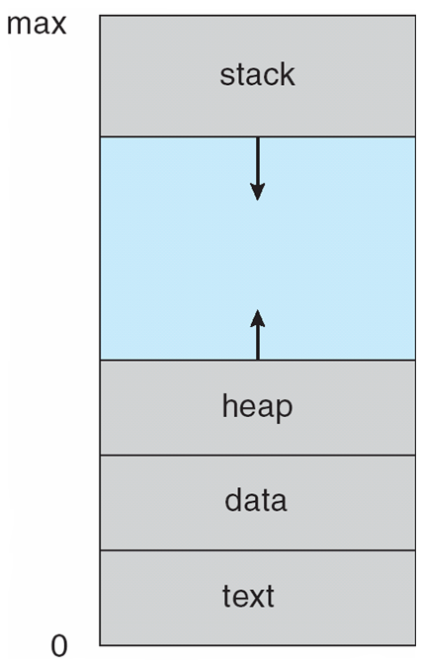
Process in Memory

Slide 7
Process in Memory
The text section comprises the compiled program code, read in from non-volatile storage when the program is launched.
The data section stores global and static variables, allocated and initialized prior to executing main.
The heap is used for dynamic memory allocation, and is managed via calls to new, delete, malloc, free, etc.
The stack is used for local variables. Space on the stack is reserved for local variables when they are declared ( at function entrance or elsewhere, depending on the language ), and the space is freed up when the variables go out of scope. Note that the stack is also used for function return values, and the exact mechanisms of stack management may be language specific.
Note that the stack and the heap start at opposite ends of the process's free space and grow towards each other. If they should ever meet, then either a stack overflow error will occur, or else a call to new or malloc will fail due to insufficient memory available.

Slide 8
Process State
As a process executes, it changes state
new: The process is being created
running: Instructions are being executed
waiting: The process is waiting for some event to occur
ready: The process is waiting to be assigned to a processor
terminated: The process has finished execution

Slide 9
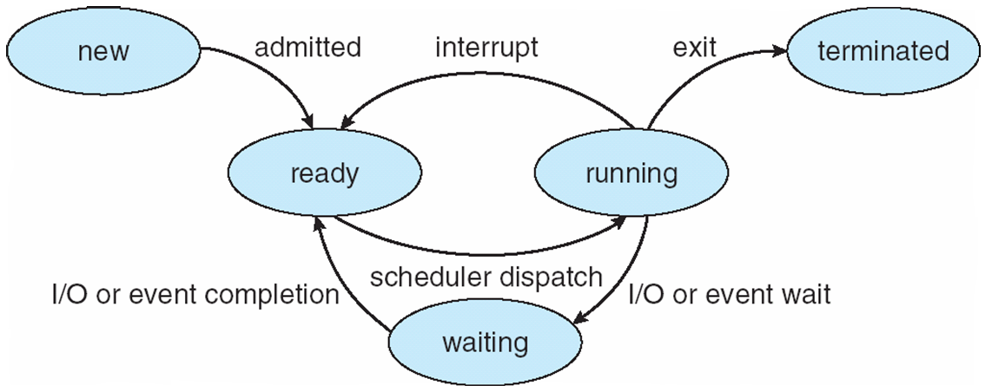
Diagram of Process State

Slide 10
Process Control Block (PCB)
Information associated with each process
Process state
Program counter
CPU registers
CPU scheduling information
Memory-management information
Accounting information
I/O status information

Slide 11
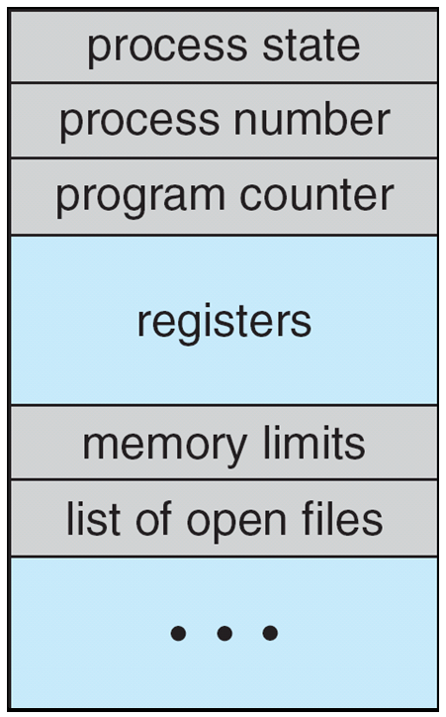
Process Control Block (PCB)

Slide 12
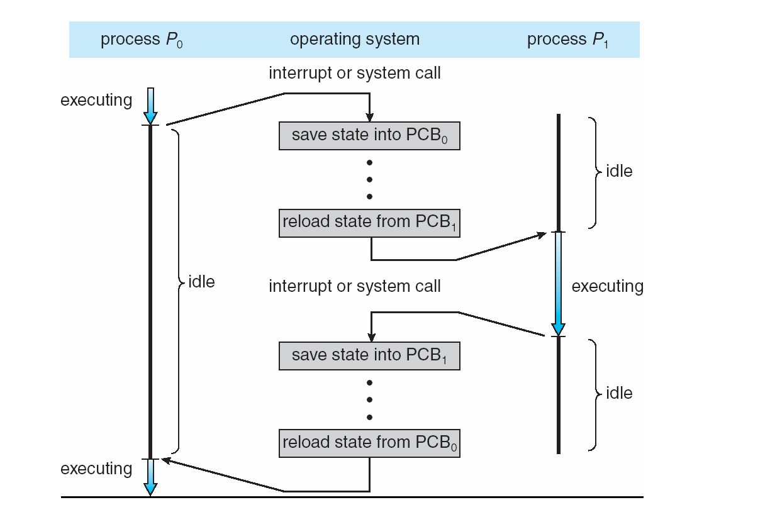
CPU Switch From Process to Process

Slide 13
Process Scheduling
Maximize CPU use, quickly switch processes onto CPU for time sharing
Process scheduler selects among available processes for next execution on CPU
Maintains scheduling queues of processes
Job queue – set of all processes in the system
Ready queue – set of all processes residing in main memory, ready and waiting to execute
Device queues – set of processes waiting for an I/O device
Processes migrate among the various queues

Slide 14
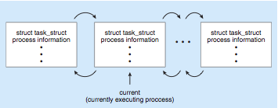
Process Representation in Linux
Represented by the C structure task_struct pid t pid; /* process identifier */ long state; /* state of the process */ unsigned int time slice /* scheduling information */ struct task struct *parent; /* this process’s parent */ struct list head children; /* this process’s children */ struct files struct *files; /* list of open files */ struct mm struct *mm; /* address space of this pro */

Slide 15
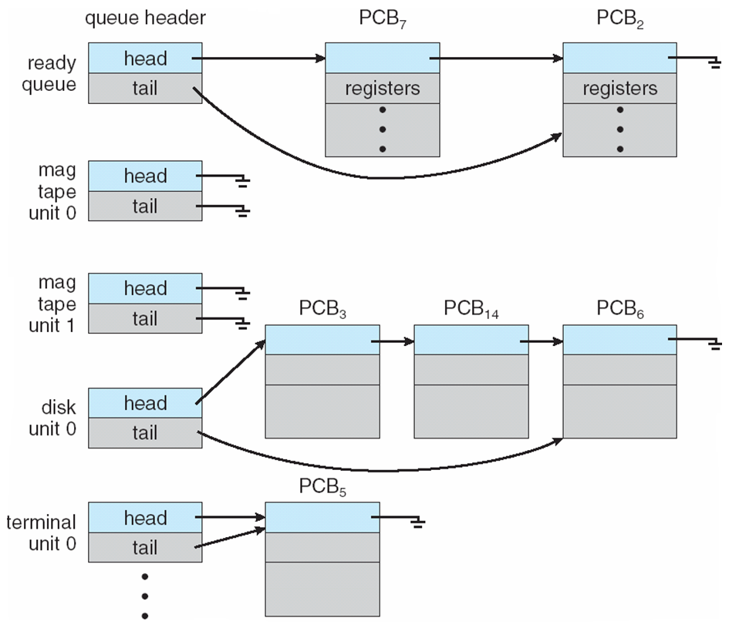
Ready Queue And Various I/O Device Queues

Slide 16
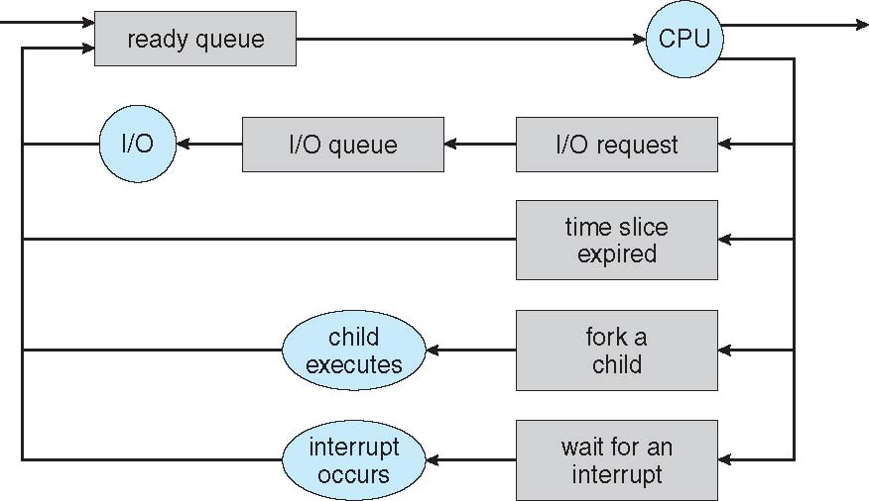
Representation of Process Scheduling

Slide 17
Schedulers
Long-term scheduler (or job scheduler) – selects which processes should be brought into the ready queue
Short-term scheduler (or CPU scheduler) – selects which process should be executed next and allocates CPU
Sometimes the only scheduler in a system

Slide 18
Schedulers (Cont.)
Short-term scheduler is invoked very frequently (milliseconds) ⇒ (must be fast)
Long-term scheduler is invoked very infrequently (seconds, minutes) ⇒ (may be slow)
The long-term scheduler controls the degree of multiprogramming
Processes can be described as either:
I/O-bound process – spends more time doing I/O than computations, many short CPU bursts
CPU-bound process – spends more time doing computations; few very long CPU bursts

Slide 19
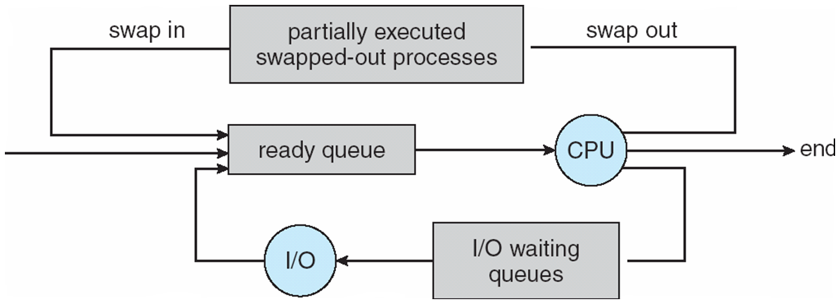
Addition of Medium Term Scheduling

Slide 20
Context Switch
When CPU switches to another process, the system must save the state of the old process and load the saved state for the new process via a context switch.
Context of a process represented in the PCB
Context-switch time is overhead; the system does no useful work while switching
The more complex the OS and the PCB -> longer the context switch
Time dependent on hardware support
Some hardware provides multiple sets of registers per CPU -> multiple contexts loaded at once

Slide 21
Process Creation
Parent process create children processes, which, in turn create other processes, forming a tree of processes
Generally, process identified and managed via a process identifier (pid)
Resource sharing
Parent and children share all resources
Children share subset of parent’s resources
Parent and child share no resources
Execution
Parent and children execute concurrently
Parent waits until children terminate

Slide 22
Process Creation (Cont.)
Address space
Child duplicate of parent
Child has a program loaded into it
UNIX examples
fork system call creates new process
exec system call used after a fork to replace the process’ memory space with a new program

Slide 23
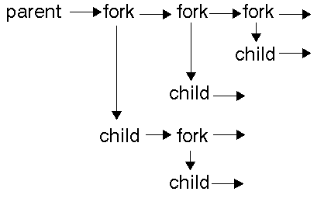
The Unix API allows creation of asynchronous processes where each process has a parent. Each process has a process ID (a number) that can be used to tell them apart. This PID is shown in the user-level command ``ps''. Because the parent process can resume execution before a child terminates, the parent can continue to create processes. The children can also create processes.
Source:https://support.dce.felk.cvut.cz/pos/os_api/unix-7.html

Slide 24
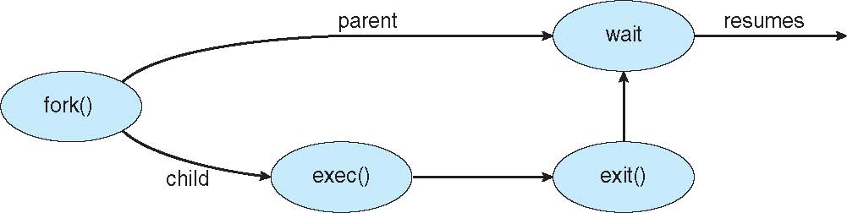
Process Creation
Typically the exec() system call is after the fork()
Fork() system call – creates a new process
New process gets a copy of the address space of the parent
Both processes continue executing next instruction after the fork()
Difference in return code from the fork
child receive 0
Parent receive pid of child (non-zero)
can be used to distinguish itself from parent
exec() to load new binary into memory
Parent can wait on the child using wait()

Slide 25
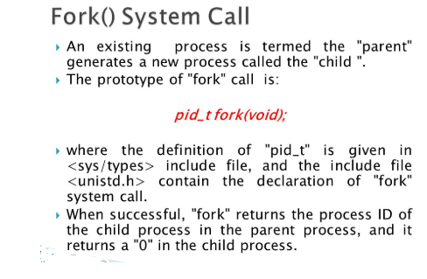

Slide 26
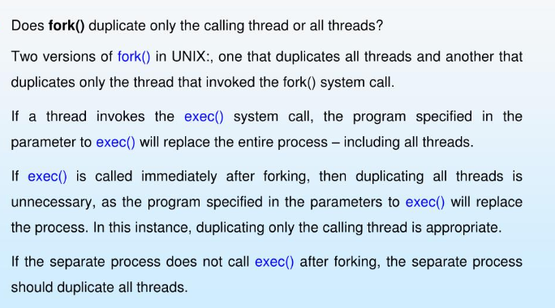

Slide 27
C Program Forking Separate Process
#include <sys/types.h>
#include <studio.h>
#include <unistd.h>
int main()
{
pid_t pid;
/* fork another process */
pid = fork();
if (pid < 0) { /* error occurred */
fprintf(stderr, "Fork Failed");
return 1;
}
else if (pid == 0) { /* child process */
execlp("/bin/ls", "ls", NULL);
}
else { /* parent process */
/* parent will wait for the child */
wait (NULL);
printf ("Child Complete");
}
return 0;
}
More reference :https://www.geeksforgeeks.org/exec-family-of-functions-in-c/

Slide 28
execlp and execl : These two also serve the same purpose but the syntax of them are a bit different which is as shown below:Syntax:
int execlp(const char *file, const char *arg,.../* (char *) NULL */);
int execl(const char *path, const char *arg,.../* (char *) NULL */);
file: file name associated with the file being executed const char *arg and ellipses : describe a list of one or more pointers to null-terminated strings that represent the argument list available to the executed program.

Slide 29
fork vs exec
fork starts a new process which is a copy of the one that calls it, while exec replaces the current process image with another (different) one.
Both parent and child processes are executed simultaneously in case of fork() while Control never returns to the original program unless there is an exec() error.

Slide 30
Process Termination
Process executes last statement and asks the operating system to delete it (exit)
Output data from child to parent (via wait)
Process’ resources are deallocated by operating system
Parent may terminate execution of children processes (abort)
Child has exceeded allocated resources
Task assigned to child is no longer required
If parent is exiting
Some operating systems do not allow child to continue if its parent terminates
All children terminated - cascading termination

Slide 31
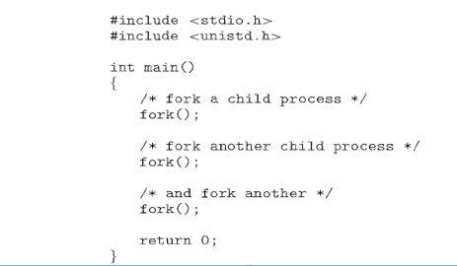

Slide 32
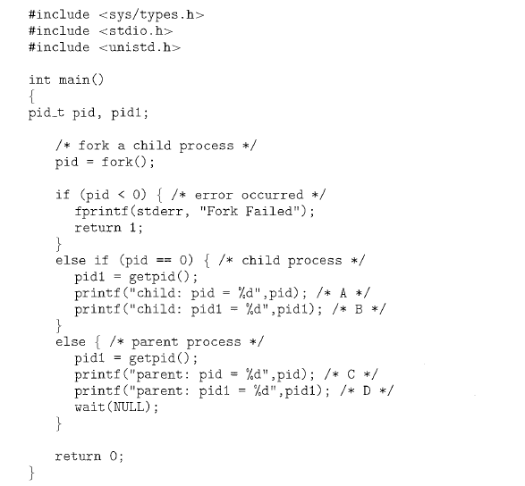


Slide 33
Interprocess Communication
Processes within a system may be independent or cooperating
Cooperating process can affect or be affected by other processes, including sharing data
Reasons for cooperating processes:
Information sharing
Computation speedup
Modularity
Convenience
Cooperating processes need interprocess communication (IPC)
Two models of IPC
Shared memory
Message passing

Slide 34
Message-passing model:
Useful for transferring small amounts of data.
Easier to implement.
Communicating processes exchanges messages with one another to transfer information.
Messages are exchanged between processes either directly or indirectly through common mailbox.
Shared-memory model:
Deliver greater speed of communication if communication takes place in the same computer.
Greater risk on protection and synchronization problems.
Processes use shared memory create and shared memory attach system calls to create and gain of memory owned by other processes.
Two processes agree to remove the restriction that only one process can access a particular part of the memory. This is done to facilitate interprocess communication by sharing the memory.
This data is not controlled by the operating system but by the communicating processes.
Data can be shared by reading and writing the data to this shared areas.
The synchronization of this data is also handled by the processes.

Slide 35
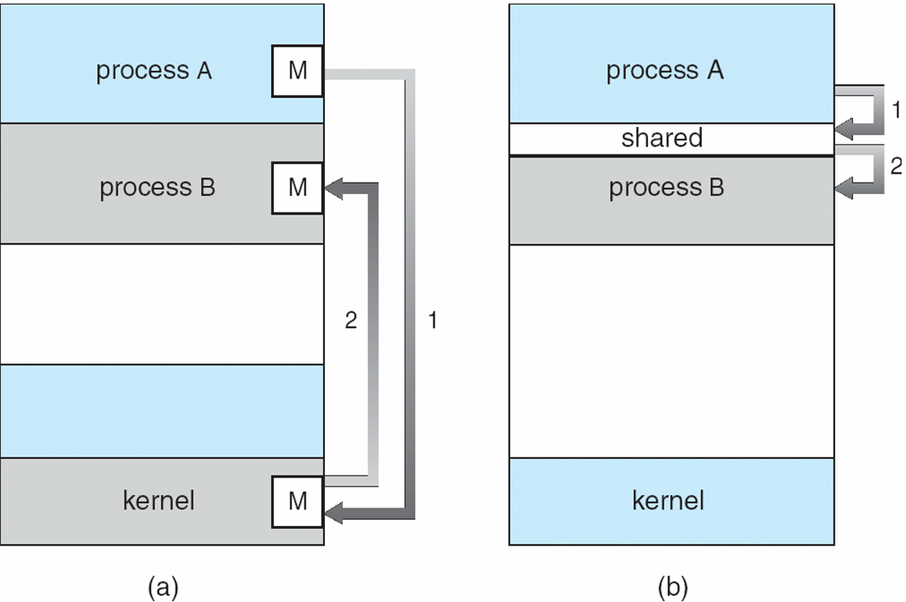
Communications Models

Slide 36
Cooperating Processes
Independent process cannot affect or be affected by the execution of another process
Cooperating process can affect or be affected by the execution of another process
Advantages of process cooperation
Information sharing
Computation speed-up
Modularity
Convenience

Slide 37
Producer-Consumer Problem
Paradigm for cooperating processes, producer process produces information that is consumed by a consumer process
unbounded-buffer places no practical limit on the size of the buffer
bounded-buffer assumes that there is a fixed buffer size

Slide 38
Bounded-Buffer – Shared-Memory Solution
Shared data
#define BUFFER_SIZE 10
typedef struct {
. . .
} item;
item buffer[BUFFER_SIZE];
int in = 0;
int out = 0;
Solution is correct, but can only use BUFFER_SIZE-1 elements

Slide 39
Bounded-Buffer – Producer
while (true) { /* Produce an item */
while (((in = (in + 1) % BUFFER SIZE count) == out)
; /* do nothing -- no free buffers */
buffer[in] = item;
in = (in + 1) % BUFFER SIZE;
}

Slide 40
Bounded Buffer – Consumer
while (true) {
while (in == out)
; // do nothing -- nothing to consume
// remove an item from the buffer
item = buffer[out];
out = (out + 1) % BUFFER SIZE;
return item;
}

Slide 41
Interprocess Communication – Message Passing
Mechanism for processes to communicate and to synchronize their actions
Message system – processes communicate with each other without resorting to shared variables
IPC facility provides two operations:
send(message) – message size fixed or variable
receive(message)
If P and Q wish to communicate, they need to:
establish a communication link between them
exchange messages via send/receive
Implementation of communication link
physical (e.g., shared memory, hardware bus)
logical (e.g., logical properties)

Slide 42
Implementation Questions
How are links established?
Can a link be associated with more than two processes?
How many links can there be between every pair of communicating processes?
What is the capacity of a link?
Is the size of a message that the link can accommodate fixed or variable?
Is a link unidirectional or bi-directional?

Slide 43
Direct Communication
Processes must name each other explicitly:
send (P, message) – send a message to process P
receive(Q, message) – receive a message from process Q
Properties of communication link
Links are established automatically
A link is associated with exactly one pair of communicating processes
Between each pair there exists exactly one link
The link may be unidirectional, but is usually bi-directional

Slide 44
Indirect Communication
Messages are directed and received from mailboxes (also referred to as ports)
Each mailbox has a unique id
Processes can communicate only if they share a mailbox
Properties of communication link
Link established only if processes share a common mailbox
A link may be associated with many processes
Each pair of processes may share several communication links
Link may be unidirectional or bi-directional

Slide 45
Indirect Communication
Operations
create a new mailbox
send and receive messages through mailbox
destroy a mailbox
Primitives are defined as:
send(A, message) – send a message to mailbox A
receive(A, message) – receive a message from mailbox A

Slide 46
Indirect Communication
Mailbox sharing
P₁, P₂, and P₃ share mailbox A
P₁, sends; P₂ and P₃ receive
Who gets the message?
Solutions
Allow a link to be associated with at most two processes
Allow only one process at a time to execute a receive operation
Allow the system to select arbitrarily the receiver. Sender is notified who the receiver was.

Slide 47
Synchronization
Message passing may be either blocking or non-blocking
Blocking is considered synchronous
Blocking send has the sender block until the message is received
Blocking receive has the receiver block until a message is available
Non-blocking is considered asynchronous
Non-blocking send has the sender send the message and continue
Non-blocking receive has the receiver receive a valid message or null

Slide 48
Buffering
Queue of messages attached to the link; implemented in one of three ways
1. Zero capacity – 0 messages Sender must wait for receiver (rendezvous)
2. Bounded capacity – finite length of n messages Sender must wait if link full
3. Unbounded capacity – infinite length Sender never waits

Slide 49
Pipes
Acts as a conduit allowing two processes to communicate
Issues
Is communication unidirectional or bidirectional?
In the case of two-way communication, is it half or full-duplex?
Must there exist a relationship (i.e. parent-child) between the communicating processes?
Can the pipes be used over a network?

Slide 50
Ordinary Pipes
Ordinary Pipes allow communication in standard producer-consumer style
Producer writes to one end (the write-end of the pipe)
Consumer reads from the other end (the read-end of the pipe)
Ordinary pipes are therefore unidirectional
Require parent-child relationship between communicating processes

Slide 51
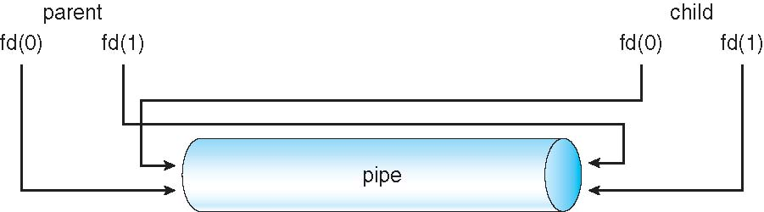
Ordinary Pipes

Slide 52
Named Pipes
Named Pipes are more powerful than ordinary pipes
Communication is bidirectional
No parent-child relationship is necessary between the communicating processes
Several processes can use the named pipe for communication
Provided on both UNIX and Windows systems

Slide 53
End of Chapter 3

